Slide 1
Section 1. Basics of Data Visualization
Lection 2. Types of data. Data preprocessing.

Slide 2
Quantitative and Categorical Data
Quantitative data – numerical values
“How many or how much?”
Categorical data – labels or names.
Limited arithmetics (counting the number of observations, computing the proportions of observations in each category).

Slide 3
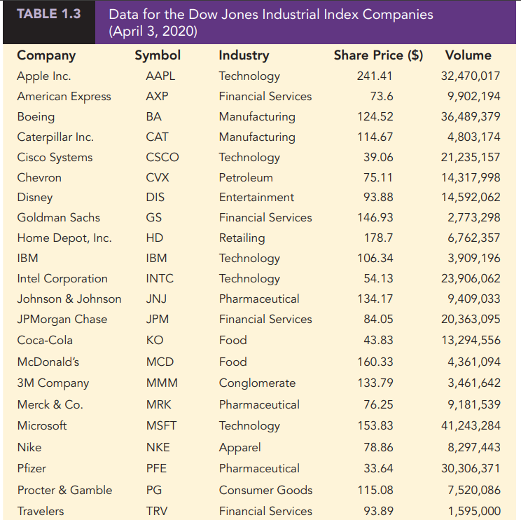
Example

Slide 4
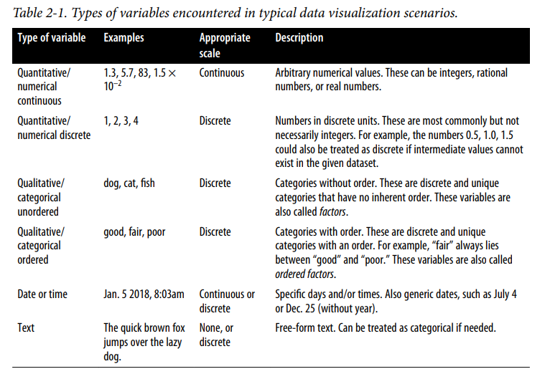
Types of data

Slide 5
Types of data
Height | Age
170.5 | 23
180.3 | 25
175 | 31
168.2 | 29

Slide 6
Types of data

Slide 7
Types of data
Age | Height | Country | Satisfaction
23 | 170.5 | USA | Low
25 | 180.3 | UK | High
31 | 175 | USA | Medium
29 | 168.2 | DE | High

Slide 8
Types of data
Outline one more time:
Quantitative vs. Categorical
Quantitative → numerical (discrete, continuous)
Categorical → qualitative (nominal/unordered, ordinal/ordered)
Examples in real data
Discrete → number of children, count of transactions
Continuous → height, temperature
Nominal → country, gender
Ordinal → education level, rating scale (low/medium/high)

Slide 9
Types of data
Quantitative vs. Categorical
Quantitative → numerical (discrete, continuous)
Categorical → qualitative (nominal/unordered, ordinal/ordered)
Examples in real data
Discrete → number of children, count of transactions
Continuous → height, temperature
Nominal → country, gender
Ordinal → education level, rating scale (low/medium/high)
And that's it?

Slide 10
Types of data
Quantitative vs. Categorical
Quantitative → numerical (discrete, continuous)
Categorical → qualitative (nominal/unordered, ordinal/ordered)
Examples in real data
Discrete → number of children, count of transactions
Continuous → height, temperature
Nominal → country, gender
Ordinal → education level, rating scale (low/medium/high)
And that's it?

Slide 11
Example (Cross-sectional data)

Slide 12
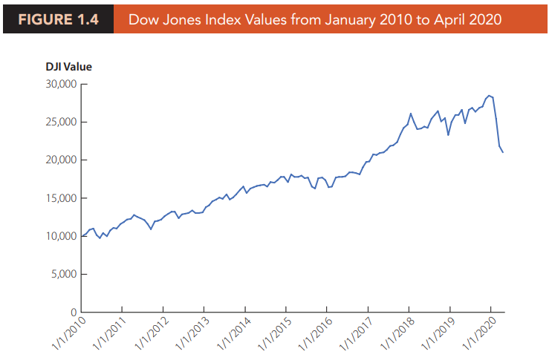
Example (Time series data)

Slide 13
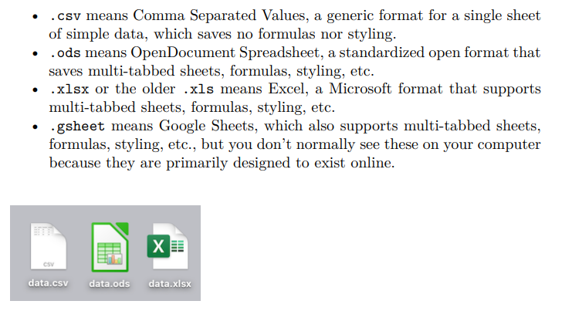
Data formats
JSON, SQL, …

Slide 14
Data preprocessing

Slide 15
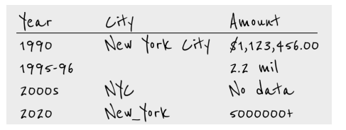
Clean Up Messy Data

Slide 16
Data Preprocessing
Handling missing values:
Drop, fill with mean/median/mode, forward/backward fill
Normalization & scaling:
Min-Max scaling
Standardization (z-score)
Cleaning text data:
lowercasing, stripping whitespace

Slide 17
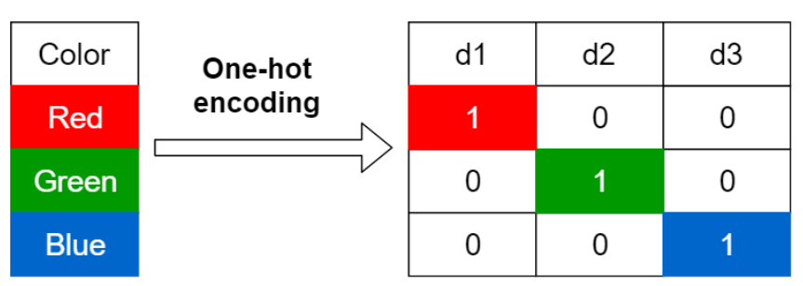
Working with Categorical Data
Encoding categorical 🔠 → numeric 🔢
Label Encoding vs. One-Hot Encoding
Label Encoding
Assigns each category 🔠 a unique integer 🔢
Pros:
simple and memory-efficient (only one column)
Works well with ordinal data (where order matters)
Cons:
Implies ordinal relationships even when none exist (e.g., USA = 0, DE = 2 — but does that mean DE > USA?)
One-Hot Encoding
Creates a new binary column for each category.
Pros:
Avoids false ordinal assumptions,
Ideal for nominal data (no inherent order)
Cons:
Increases dimensionality (especially with many unique categories)
Can lead to sparse matrices and overfitting in small datasets

Slide 18
Working with Time Series
sequential order, trend/seasonality
Indexing by date in pandas
Resampling, rolling averages

Slide 19
Outcomes & Predictors
Outcome / Target /Response / Dependent variable
The variable you want to explain or predict
Usually denoted as Y
Examples: exam score, sales revenue, patient recovery, churn (yes/no)
Predictors / Features /Explanatory/ Independent variables
Variables used to explain or predict the outcome
Usually denoted as X1, X2, …, Xn
Examples: study hours, advertising budget, patient age, customer visits

Slide 20
Choosing outcomes vs predictors
Outcome = the result / “what happens”
Predictors = influencing factors / “why it happens”
Analogies
Avoid circular logic (don’t use the outcome itself as a predictor)
Predictors should be plausibly related to outcome (domain knowledge helps)
Outcome must be measurable and relevant
Driven by the research question (What do we want to know or predict?)
Criteria

Slide 21
… a few more points
Data Quality
Duplicates, outliers, inconsistent values
How to detect and decide whether to drop or transform them
Data Integration
Combining multiple sources (joins, merges, concatenation in pandas, VLOOKUP/Power Query in Excel)
Issues like different formats, different keys
Data Transformation
Feature engineering (e.g., extracting month from a date, creating age from birthdate)
Aggregation (groupby in pandas, PivotTables in Excel)
Sampling
Working with subsets of data when full dataset is too large
Random sampling vs stratified sampling
Data Documentation
Metadata: keeping track of what variables mean (data dictionaries to interpret datasets)

